Slide 1
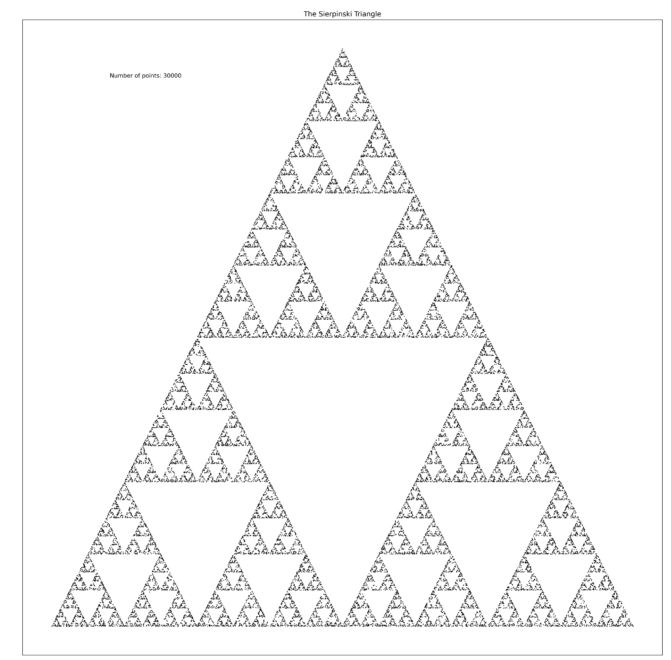
Water Infrastructure & Modeling
STEP-UP Internship Program Summer 2023
Day 2
July 24, 2023

Slide 2
Outline
AquaticAlgorithms
The modern water cycle
Water resource infrastructure
“Wicked Problems” in water resources
Simulation as a tool for water resource planning

Slide 3
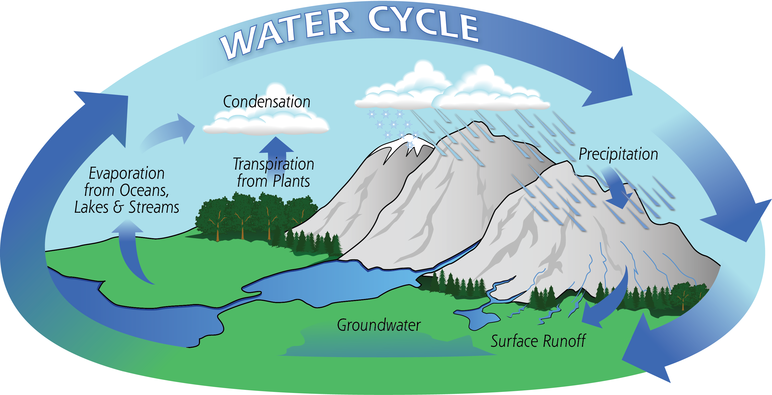
The natural water cycle
AquaticAlgorithms
Source: NASA (https://gpm.nasa.gov/education/water-cycle)

Slide 4
The natural water cycle
AquaticAlgorithms
What is missing from this diagram?
Source: NASA (https://gpm.nasa.gov/education/water-cycle)

Slide 5
The natural water cycle
AquaticAlgorithms
Source: NASA (https://gpm.nasa.gov/education/water-cycle)

Slide 6
The natural water cycle
AquaticAlgorithms
What is missing from this diagram?
Humans and human impact!
Source: NASA (https://gpm.nasa.gov/education/water-cycle)

Slide 7
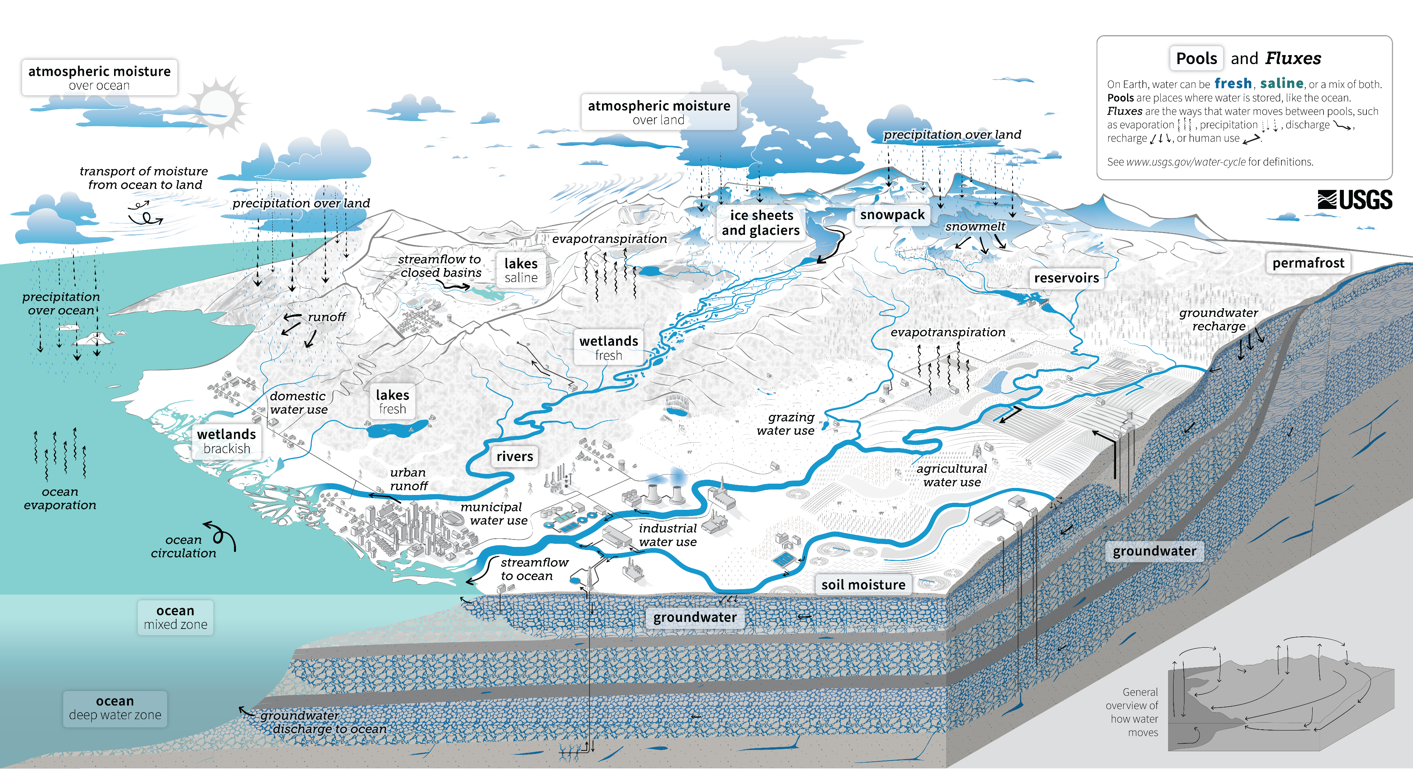
The human-natural water cycle
AquaticAlgorithms
Source: https://www.usgs.gov/special-topics/water-science-school/science/water-cycle-diagrams

Slide 8
The human-natural water cycle
AquaticAlgorithms
Source: https://www.usgs.gov/special-topics/water-science-school/science/water-cycle-diagrams

Slide 9
The human-natural water cycle
AquaticAlgorithms
Source: https://www.usgs.gov/special-topics/water-science-school/science/water-cycle-diagrams

Slide 10
The human-natural water cycle
AquaticAlgorithms
Source: https://www.usgs.gov/special-topics/water-science-school/science/water-cycle-diagrams

Slide 11
The human-natural water cycle
AquaticAlgorithms
Source: https://www.usgs.gov/special-topics/water-science-school/science/water-cycle-diagrams

Slide 12
The human-natural water cycle
AquaticAlgorithms
The water cycle (and the water resource system built inside it) is very complex...
Source: https://www.usgs.gov/special-topics/water-science-school/science/water-cycle-diagrams

Slide 13
The human-natural water cycle
AquaticAlgorithms
The water cycle (and the water resource system built inside it) is very complex...
Some may even call it wicked.
Source: https://www.usgs.gov/special-topics/water-science-school/science/water-cycle-diagrams

Slide 14
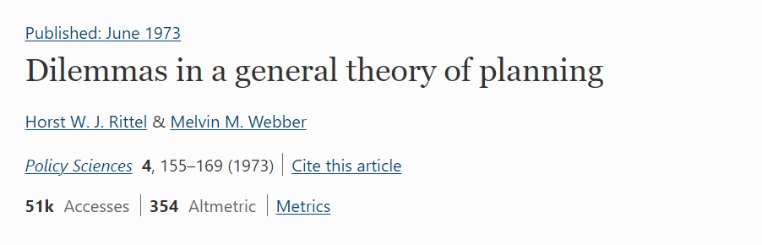
Wicked Problems
AquaticAlgorithms
https://link.springer.com/article/10.1007/bf01405730

Slide 15
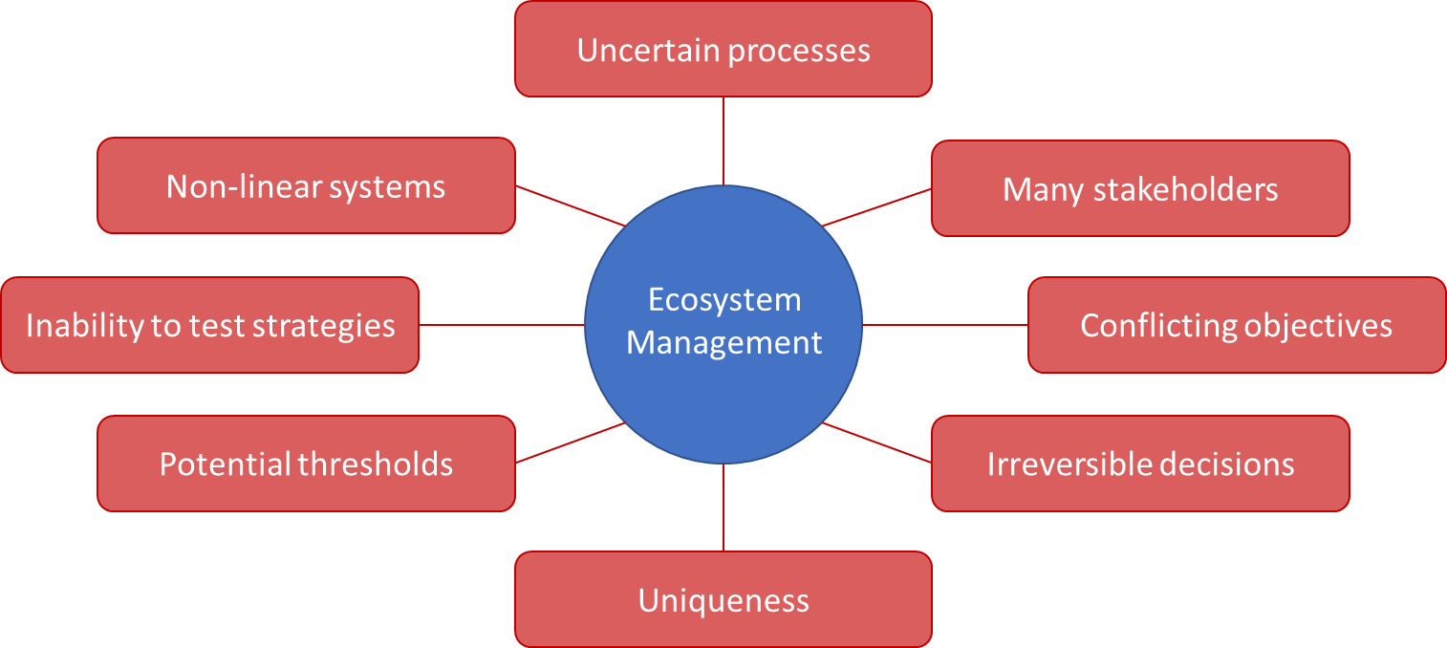

Wicked Problems
AquaticAlgorithms

Slide 16
Wicked Problems
AquaticAlgorithms

Slide 17
Wicked Problems
AquaticAlgorithms

Slide 18
Wicked Problems
AquaticAlgorithms

Slide 19
Wicked Problems
AquaticAlgorithms

Slide 20
Wicked Problems
AquaticAlgorithms

Slide 21
Wicked Problems
AquaticAlgorithms

Slide 22
Wicked Problems
AquaticAlgorithms

Slide 23
Wicked Problems
AquaticAlgorithms

Slide 24
Example: My work in the Delaware River Basin
AquaticAlgorithms

Slide 25
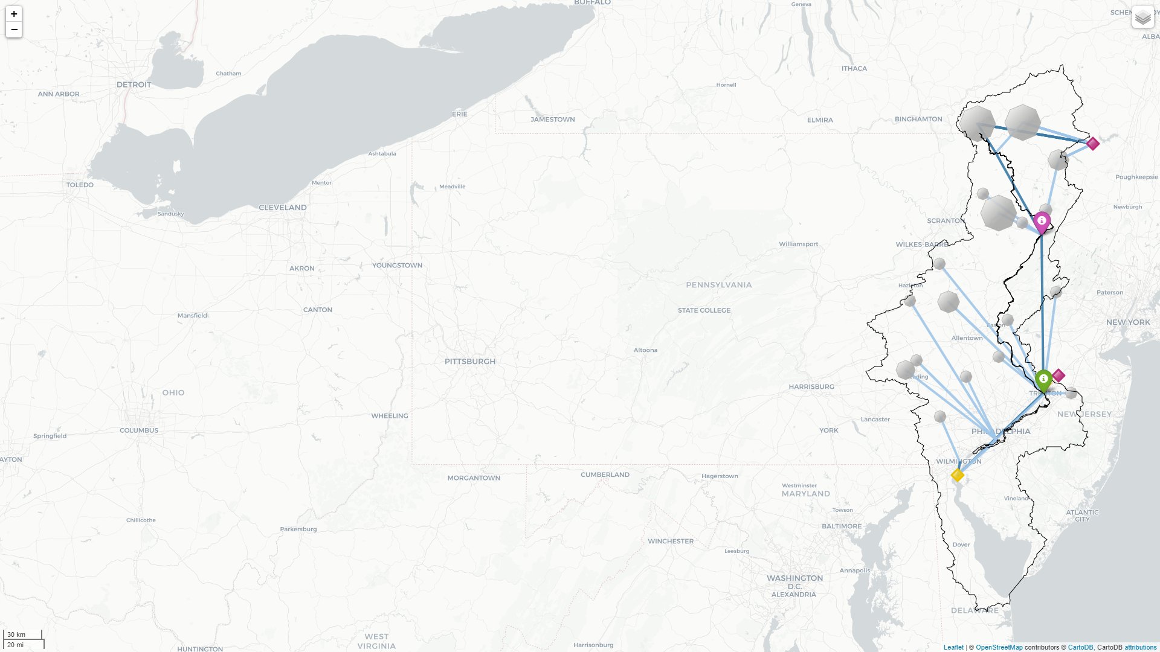


Major management objectives
M&I water
Habitat

Slide 26
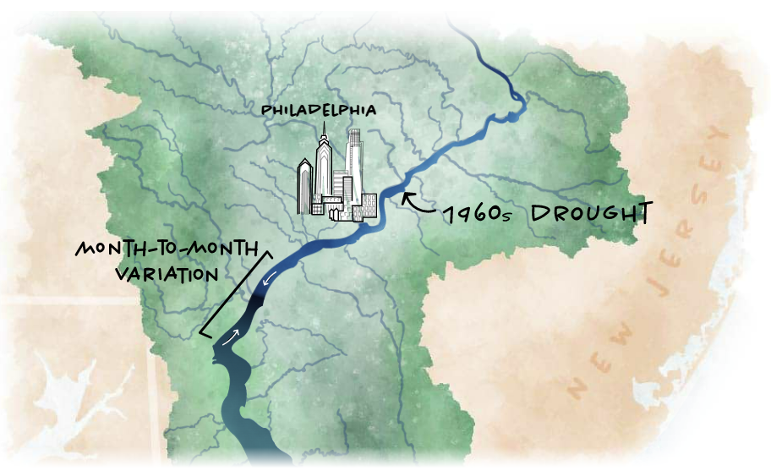
Major management objectives
M&I water
Habitat

Slide 27




Major management objectives
M&I water
Flood control
Electricity
Irrigation
Habitat
Recreation

Slide 28
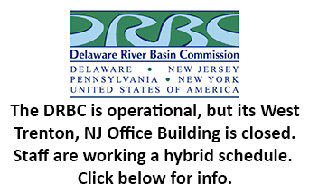







Unique governance
State & Municipal
PA
NJ
Federal
DE
NYS
NYC
USGS
USACE

Slide 29
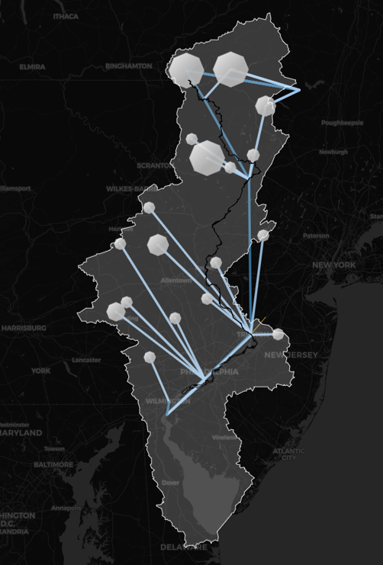
Example: My work in the Delaware River Basin
AquaticAlgorithms
Natural Flows
Managed Flows

Slide 30
Example: My work in the Delaware River Basin
AquaticAlgorithms
See drb_model_map.html

Slide 31
Activity: Choose Case Study Location
AquaticAlgorithms
Google search: USGS NWIS
Search for some gauge locations that you are interested in.
Answer the following questions (NOTE: these do not have “correct” answers):
Why this location?
What is upstream of this location (natural and human)?
What is downstream of this location?
Who or what depends on this water?
What are some water resource challenges that may exist in the region (brainstorm)?

Slide 32
Next Time
AquaticAlgorithms
Testing body text

